Slide 1



Electronic Medical Records System
By Blaine Rudow

Slide 2
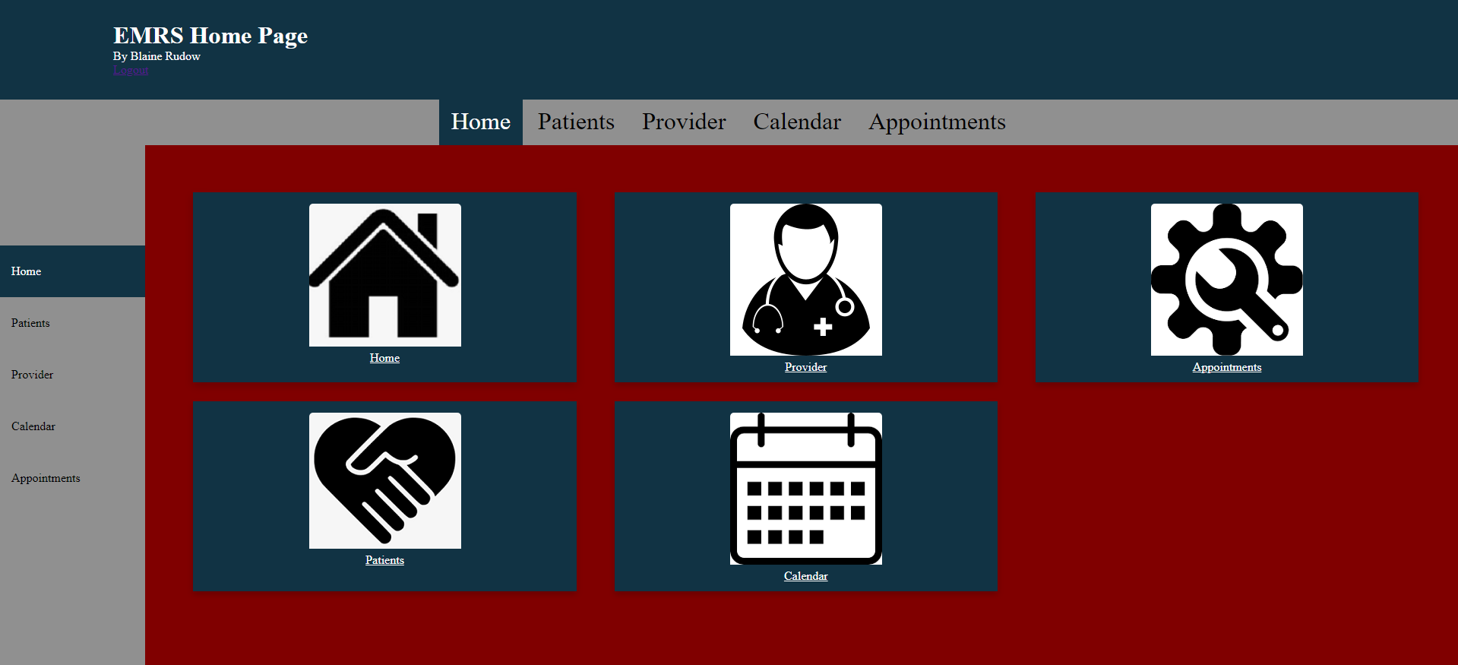
EMRS Home Page
Home page has several icons
Navigation bars on the top and left link to each other major feature
Logout button at the top right exists to exit the system

Slide 3
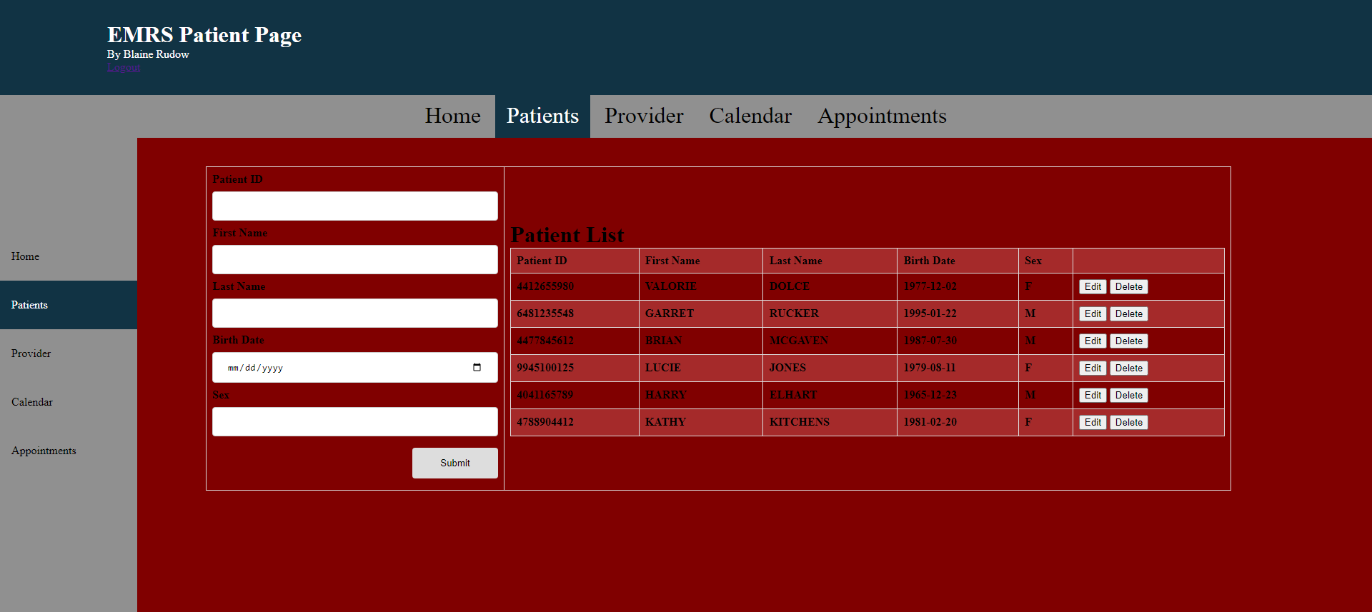
EMRS Patient Page
The Patient Page includes three search bars at the top of the content area where patients can be searched by their information.
The table provides a list of relevant patients
Two buttons at the bottom can select a patient to go to a specific patients chart, or new patient pulls up a form to create a new patient.

Slide 4
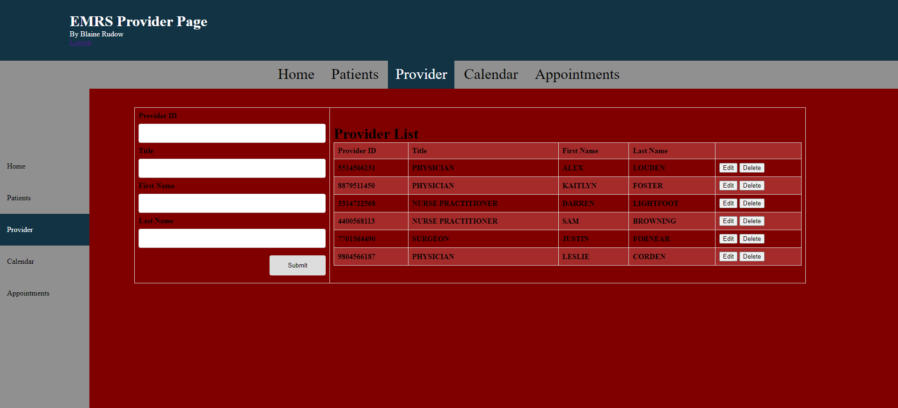
EMRS Provider Page
The providers page includes fields on the left where new providers can be added.
The table on the right displays the providers in the system and their details.
The table lists the provider ID, providers first name, last name and title.
Two buttons on the right allow you to edit the providers or delete the providers.

Slide 5
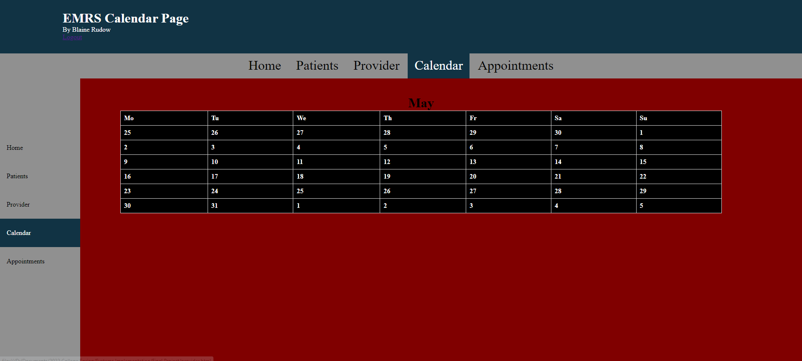
EMRS Calendar page
The calendar page shows the days of the month.
Navigation bars on the top and left side of the page allow for easy access to other parts of the program.

Slide 6
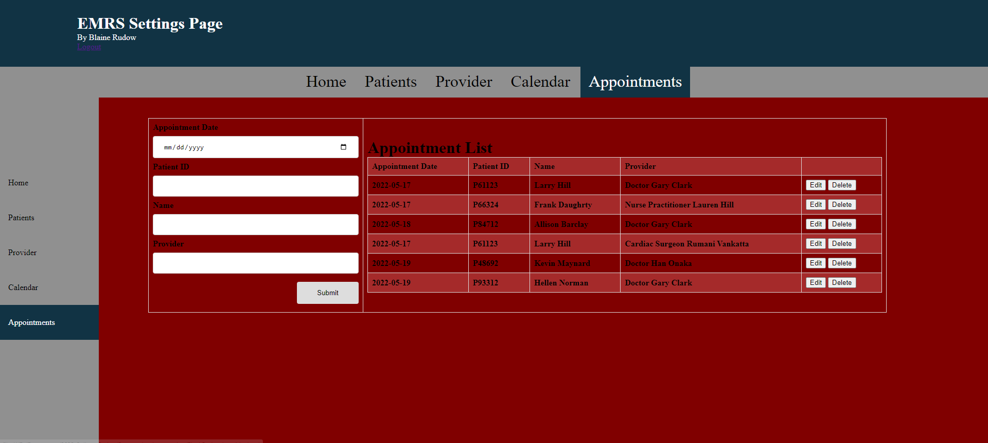
EMRS Appointments Page
The fields on the left allow you to edit or enter new appointments.
The table on the right allows you to view the current listed appointments.
Two buttons on the right allow you to edit or delete current appointments.

Slide 7
EMRS Patient Page
The Patient page has fields where users can input new patients.
The table provides a list of patients
Two buttons at the right can select a patient to go to edit a patient, or delete a patient.

